Slide 1
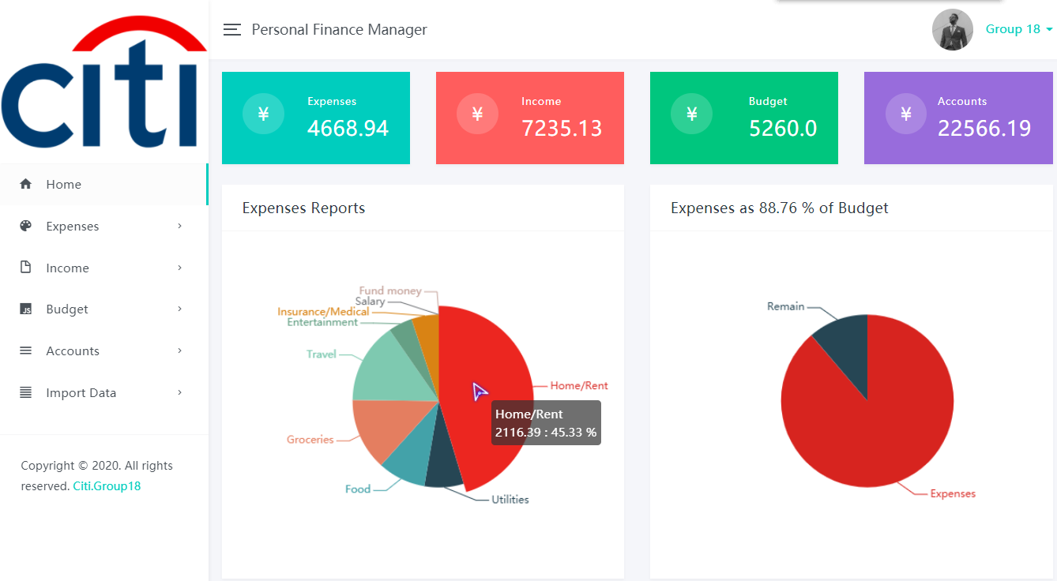
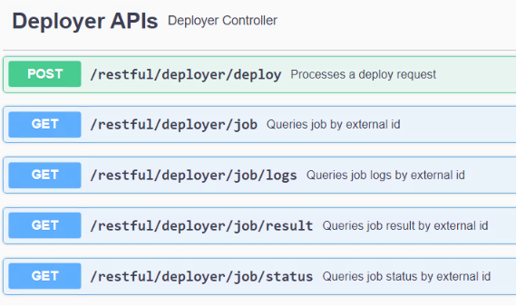
To be continued …
Personal Finance Manager
Onboard
Consumer
Flink
LS Stage
Split
Distinct
Fix Bugs
Features
LS App Deployer API
Personal
Improve
Notes:
PFM: Djano + MySQL
Flink
Stage: split / distict
Fix: support cti -> jira id / comment
Deployer: job engine / create uat env
Personal: work principle / business

